Slide 1
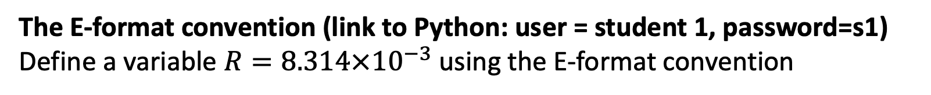
Week 1
The E-format convention (link to Python: user = student 1, password=s1)
Define a variable $R=8.314×{10}^{−3}$using the E-format convention

Slide 2

Week 1
Variables with units (link to Python: user = student 1, password=s1))
Use AssignQuantity to define the variable $R=8.314×{10}^{−3}\frac{kJ}{mol K}$,

Slide 3
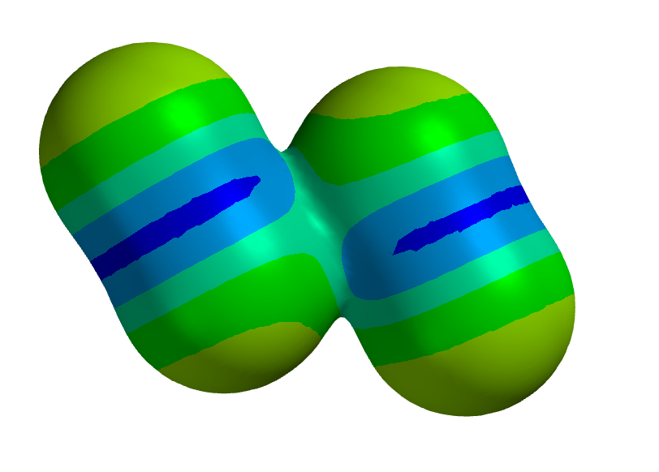
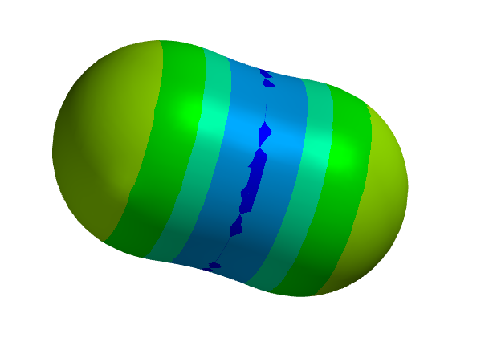
Week 1
Intermolecular bond strengths, part 1 (screenshare Spartan)
What information from Spartan is used to get an intermolecular bond strength?

Slide 4
Week 1
Intermolecular bond strengths, part 2 (screenshare Spartan)
What’s the meaning of the colors in these electrostatic potential maps?

Slide 5
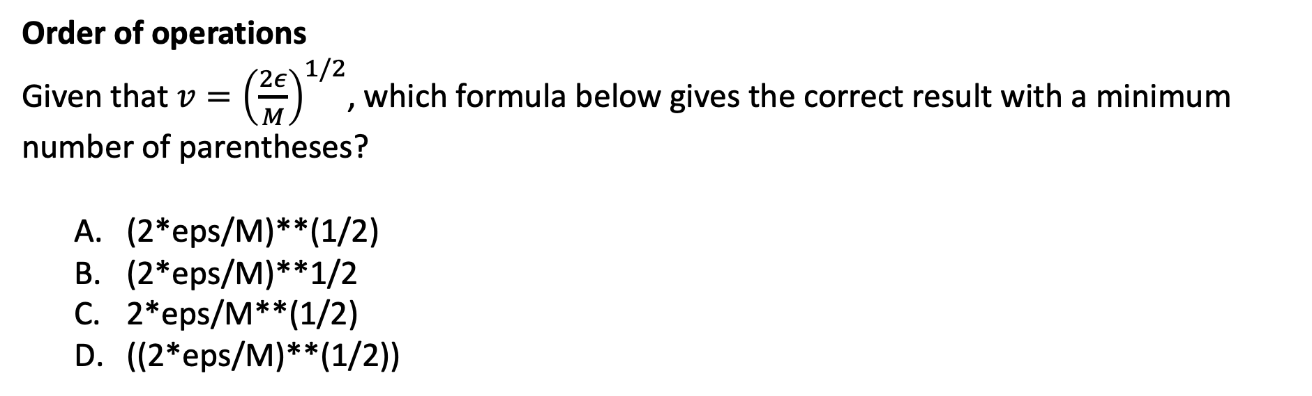
Week 1
Order of operations
Given that $v={\left(\frac{2ε}{M}\right)}^{1/2}$, which formula below gives the correct result with a minimum number of parentheses?
(2*eps/M)**(1/2)
(2*eps/M)**1/2
2*eps/M**(1/2)
((2*eps/M)**(1/2))

Slide 6
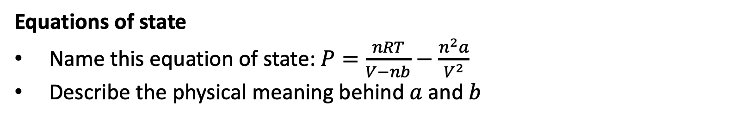
Week 1
Equations of state
Name this equation of state: $P=\frac{nRT}{V−nb}−\frac{n^{2}a}{V^{2}}$
Describe the physical meaning behind $a$ and $b$
Intermolecular forces

Slide 7
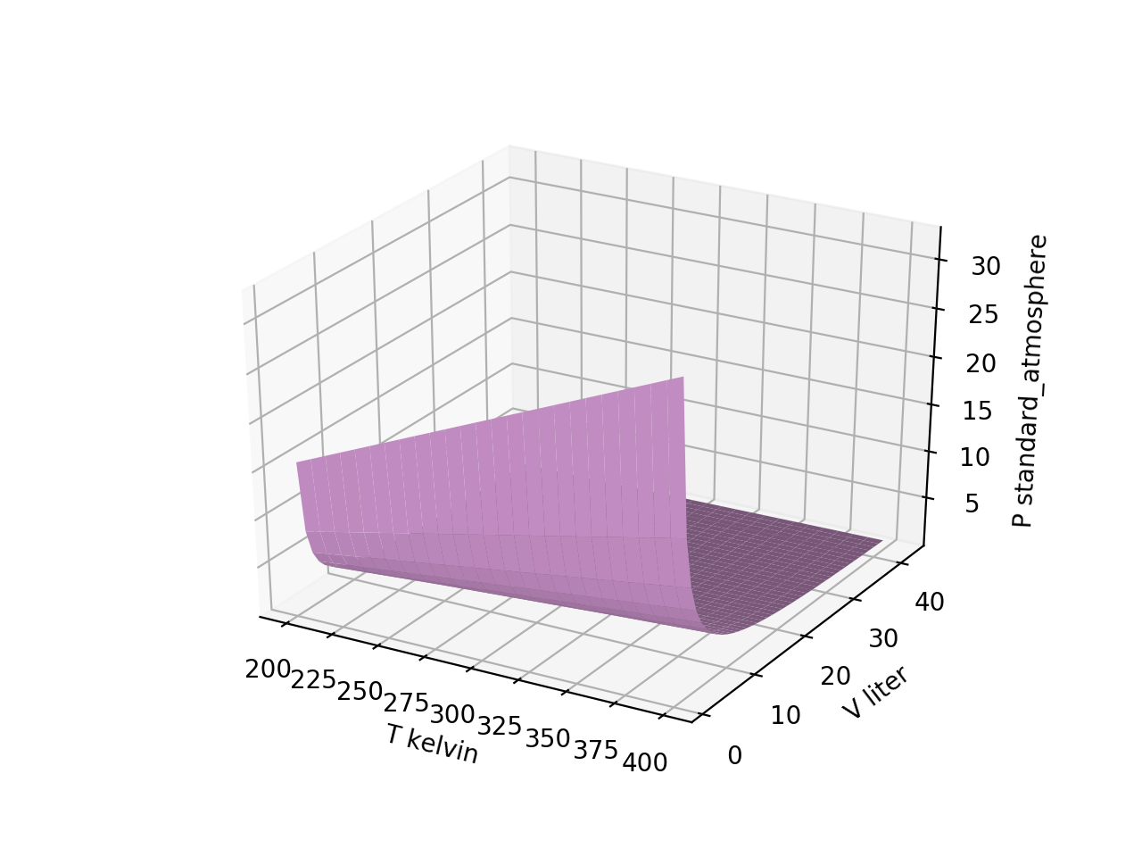
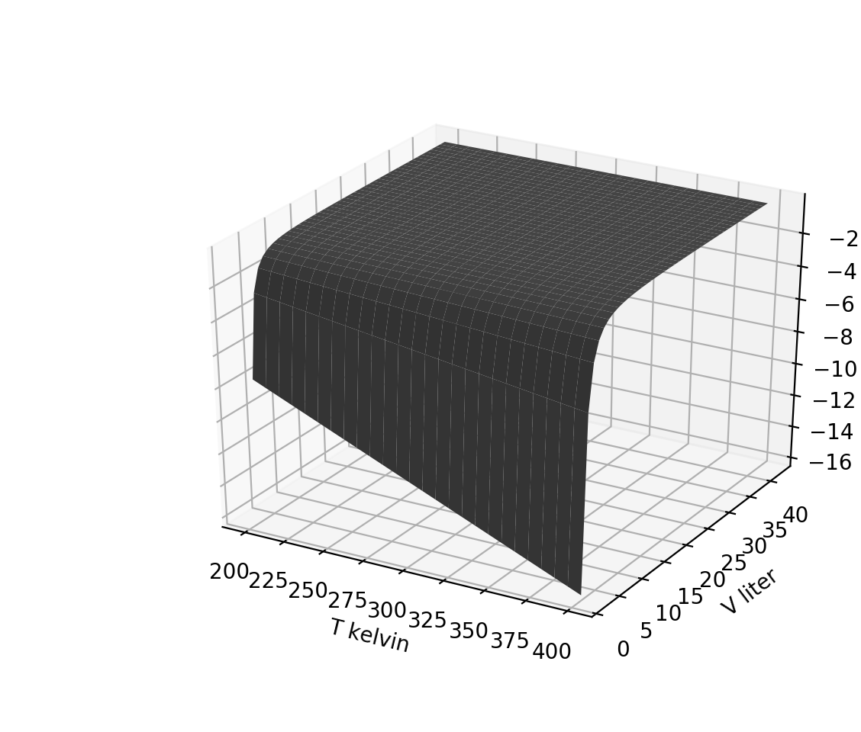

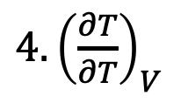
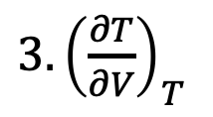
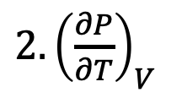
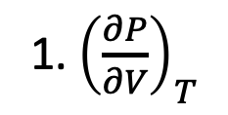
Week 2
Visualizing derivative thermodynamic surfaces, part 1
Which thermodynamic surface is the one on the right?
1. ${\left(\frac{∂P}{∂V}\right)}_{T}$
$$P(T,V)$$
$2. {\left(\frac{∂P}{∂T}\right)}_{V}$
${3. \left(\frac{∂T}{∂V}\right)}_{T}$
${4. \left(\frac{∂T}{∂T}\right)}_{V}$

Slide 8
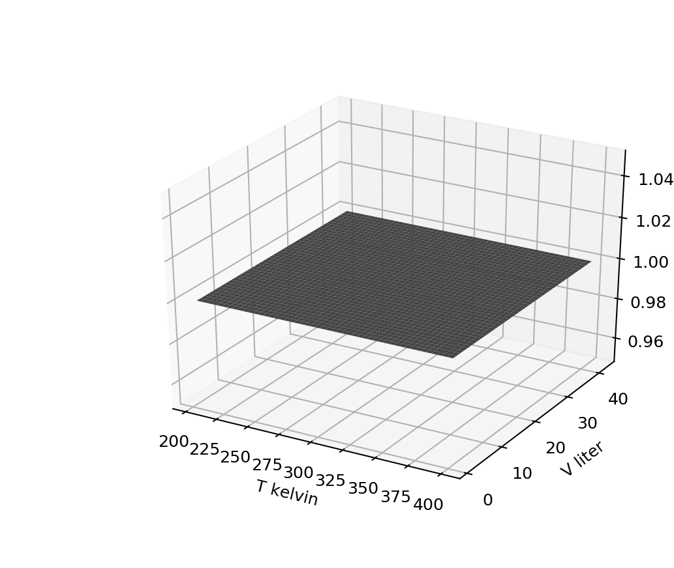
Week 2
Visualizing derivative thermodynamic surfaces, part 2
Which surface could we be looking at now?
1. ${\left(\frac{∂P}{∂V}\right)}_{T}$
$2. {\left(\frac{∂P}{∂T}\right)}_{V}$
${3. \left(\frac{∂T}{∂V}\right)}_{T}$
${4. \left(\frac{∂T}{∂T}\right)}_{V}$

Slide 9
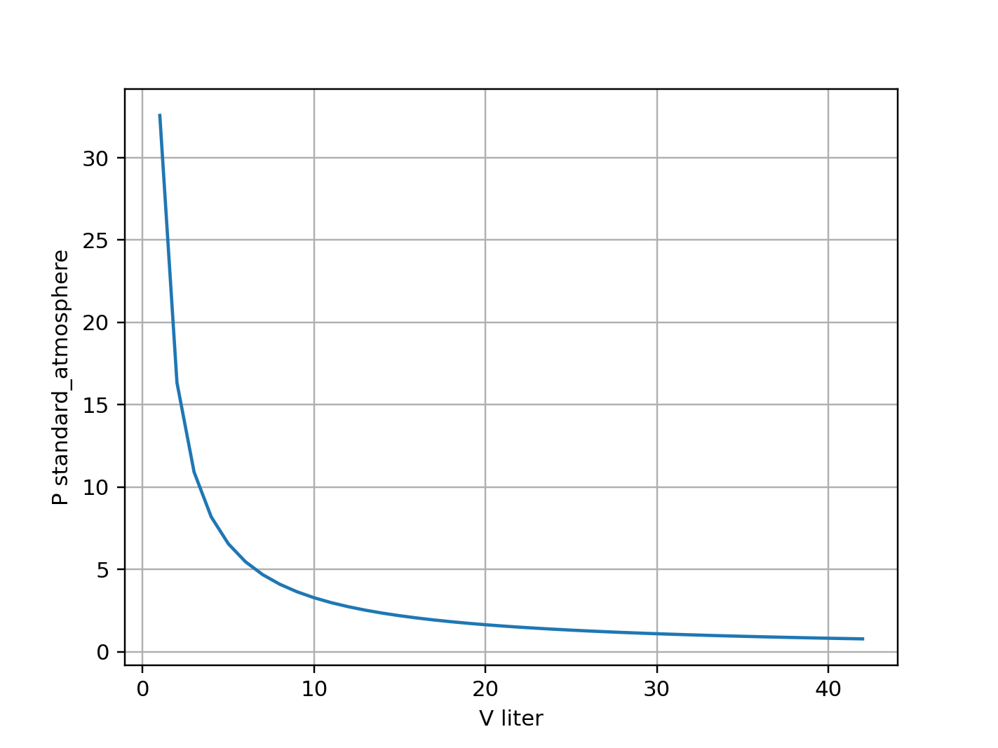

Week 2
Slicing
Assuming grids have been organized in the way we’ve been doing it, which might give you the curve shown on the right? (The number “3” is kind of arbitrary.)
$$P(T,V)$$
Pgrid[:,3]
Pgrid[3,:]
Pgrid[3,3]
Pgrid[:,:]

Slide 10
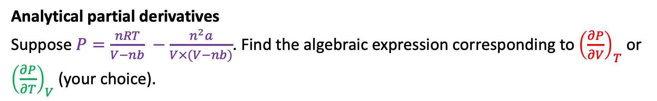
Week 2
Analytical partial derivatives
Suppose $P=\frac{nRT}{V−nb} −\frac{n^{2}a}{V×(V−nb)}$. Find the algebraic expression corresponding to ${\left(\frac{∂P}{∂V}\right)}_{T}$ or ${\left(\frac{∂P}{∂T}\right)}_{V}$ (your choice).

Slide 11
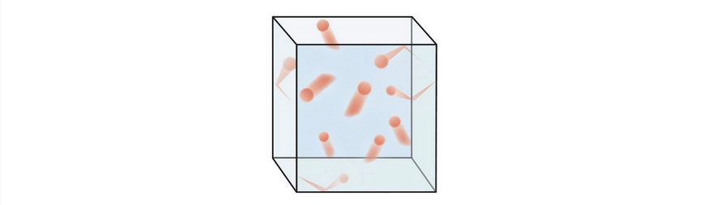
Week 3
The kinetic-molecular theory of gases
Describe a few key assumptions of the kinetic-molecular theory of gases and/or the theory behind the ideal gas law.

Slide 12

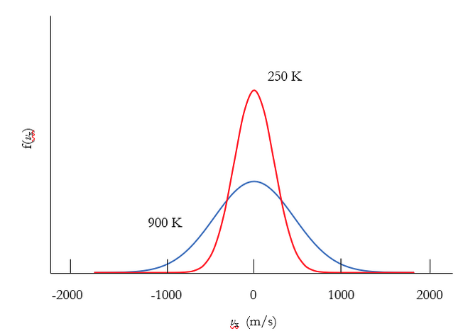
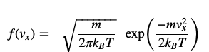
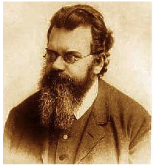
Week 3
Probability densities, part 1
What are the units of $f(v_{x})$?

Slide 13
Week 3
Probability densities, part 2
Which graph below corresponds to the heavier molecule?

Slide 14
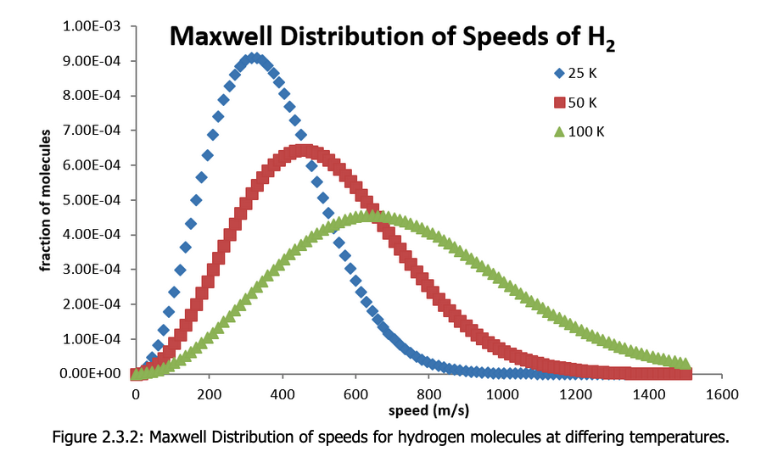

Week 3
Probabilities from probability densities
What’s the probability (as a fraction, and also in %) of finding an H₂ molecule with speed between 390 m/s and 400 m/s, if its temperature is 100 K?
$f_{M}\left(v\right)$ $(\frac{s}{m})$

Slide 15
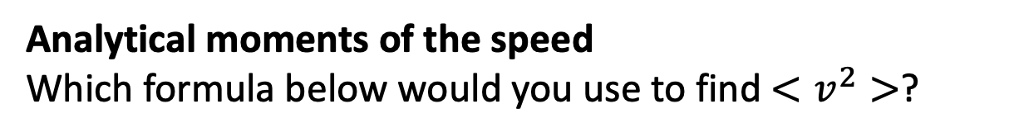

Week 3
Analytical moments of the speed
Which formula below would you use to find $<v^{2}>$?
$$f_{M}=N_{M}v^{2}\exp\left(−Dv^{2}\right)$$

Slide 16
Week 4
Equipartition
Describe what the equipartition theorem is about, with an example.

Slide 17


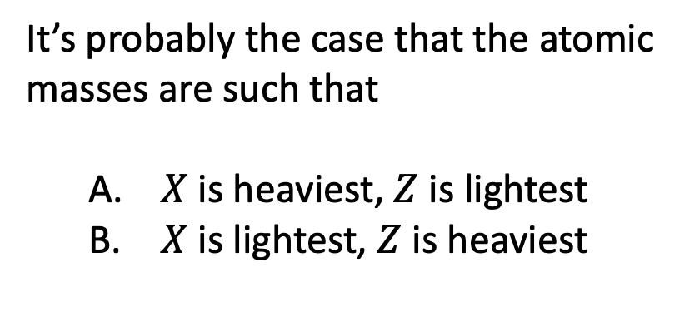
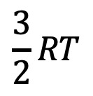

Week 4
Heat capacities, part 1
It’s probably the case that the atomic masses are such that
$X$ is heaviest, $Z$ is lightest
$X$ is lightest, $Z$ is heaviest
$$\frac{3}{2}RT$$
$$X_{2}$$
$$Y_{2}$$
$$Z_{2}$$

Slide 18
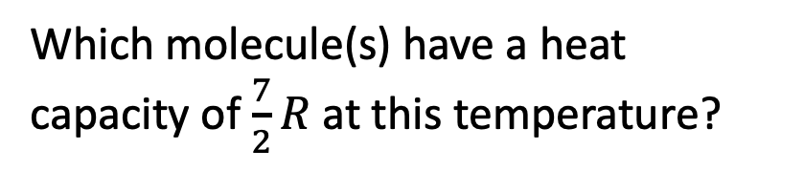
Week 4
Heat capacities, part 2
Which molecule(s) have a heat capacity of $\frac{7}{2}R$ at this temperature?
$$\frac{3}{2}RT$$
$$X_{2}$$
$$Y_{2}$$
$$Z_{2}$$

Slide 19
Week 4
Heat capacities, part 3
What’ the heat capacity of the third molecule at this temperature?
$$\frac{3}{2}RT$$
$$X_{2}$$
$$Y_{2}$$
$$Z_{2}$$

Slide 20
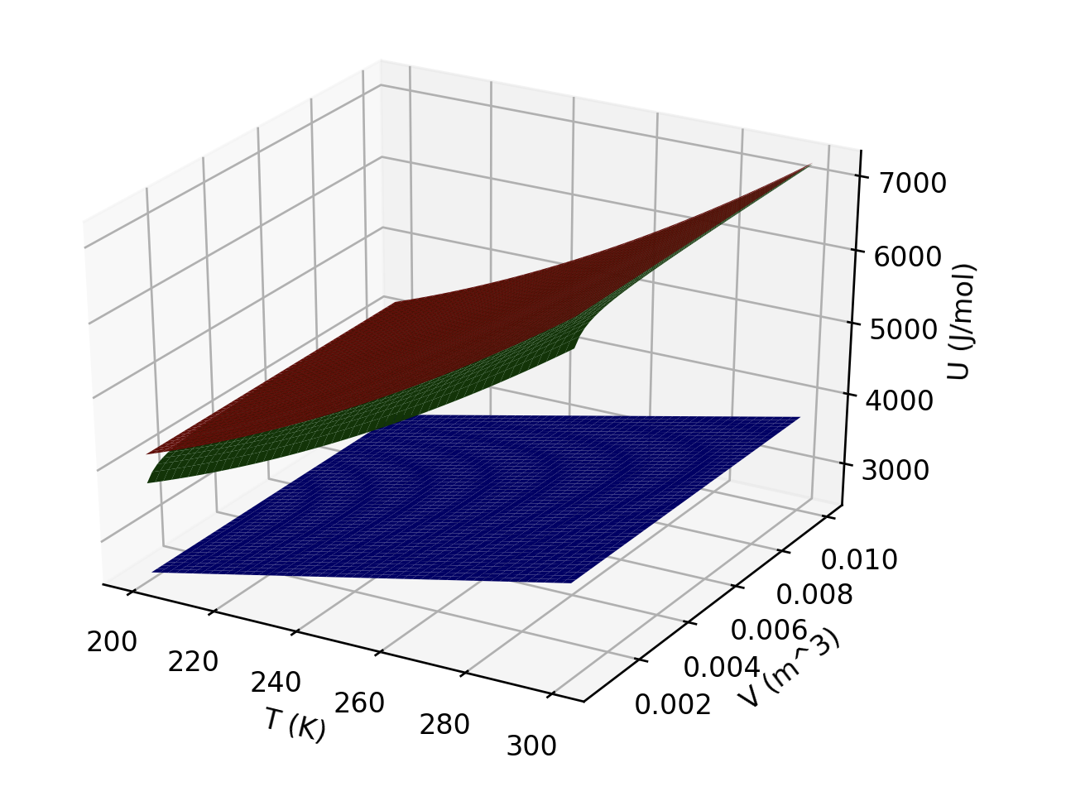
Week 4
Interpreting U(T,V)
What is responsible for the curvature of the red and green gases (in the temperature direction)?
Which gas(es) could be ideal?
Which is probably a monatomic gas?

Slide 21
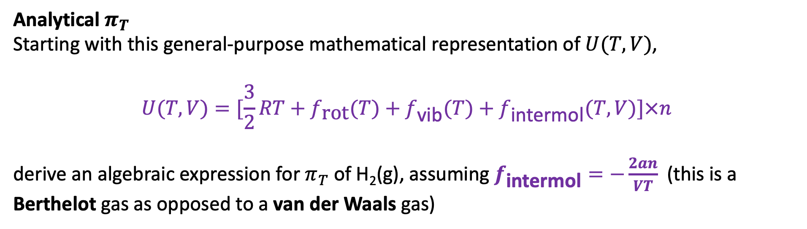
Week 4
Analytical $π_{T}$
Starting with this general-purpose mathematical representation of $U(T,V)$,
$$U(T,V)=[\frac{3}{2}RT+f_{\text{rot}}(T)+f_{\text{vib}}(T)+f_{\text{intermol}}(T,V)]×n$$
derive an algebraic expression for $π_{T}$ of H₂(g), assuming $f_{\text{intermol}}=−\frac{2an}{VT}$ (this is a Berthelot gas as opposed to a van der Waals gas)

Slide 22
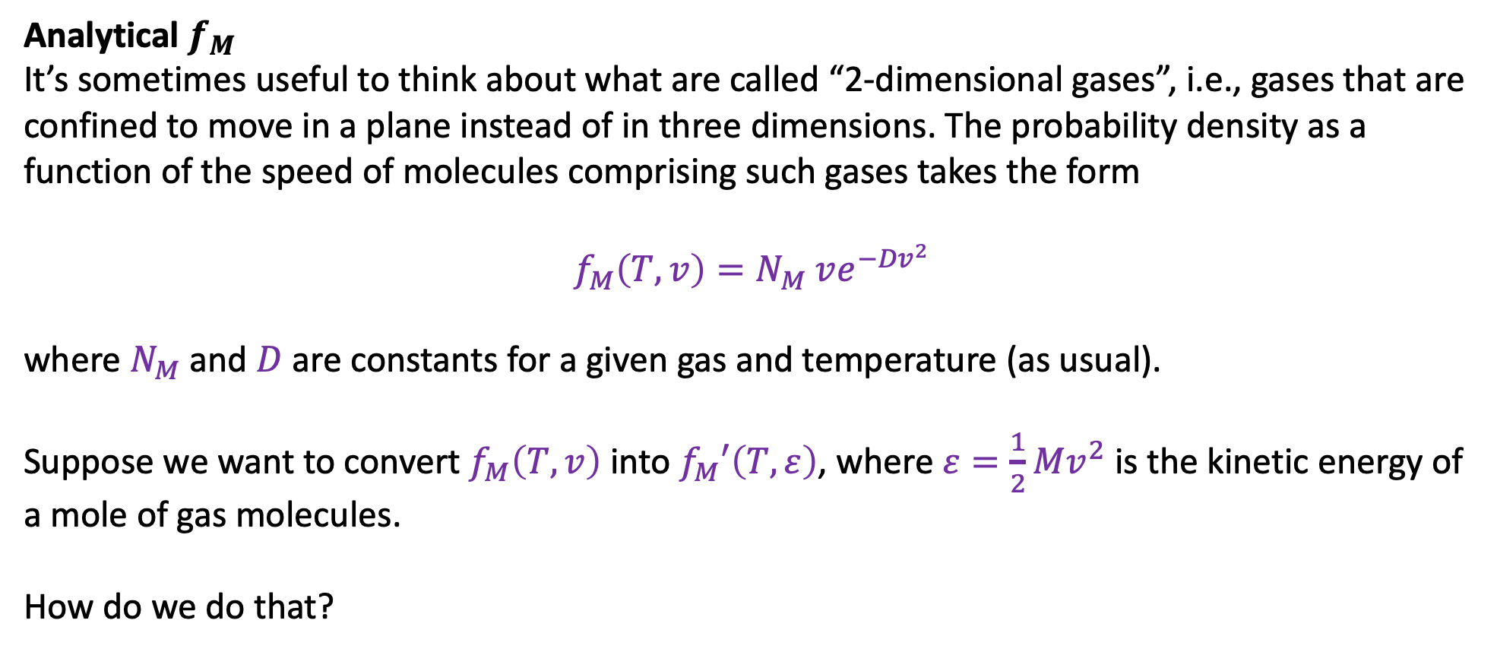
Week 4
Analytical $f_{M}$
It’s sometimes useful to think about what are called “2-dimensional gases”, i.e., gases that are confined to move in a plane instead of in three dimensions. The probability density as a function of the speed of molecules comprising such gases takes the form
$$f_{M}\left(T,v\right)=N_{M} ve^{−{Dv}^{2}}$$
where $N_{M}$and $D$ are constants for a given gas and temperature (as usual).
Suppose we want to convert $f_{M}\left(T,v\right)$ into $f_{M}′\left(T,ε\right)$, where $ε=\frac{1}{2}Mv^{2}$ is the kinetic energy of a mole of gas molecules.
How do we do that?

